Slide 1
Data Collection Plan

Slide 2
Planning your Data Collection Procedures
After you have decided on your data collection method, now you need to plan exactly how you will use them to answer your research question.

Slide 3
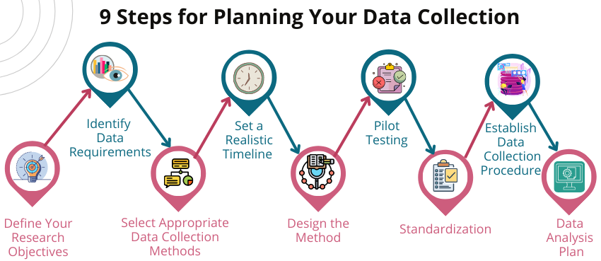

Slide 4
Before you begin data collection, it is critical to clearly articulate your research objectives. The research objectives will help you think about the types of data that are relevant to the goals. You should write the research questions and try to define them. This will implement a level of focus on the study.

Slide 5
Once you define your research objectives, you must ascertain the precise data elements you require to appropriately answer the research questions. In addition, make sure that the data is available and accessible and determine its effectiveness.

Slide 6
When considering available data, think both qualitatively and quantitatively – which could include surveys, interviews, observations, existing datasets, or experiment data studies.

Slide 7
Equally, think about the level of detail for each data point and the most applicable data collection methods.

Slide 8
Identify data collection methods that suit your research purpose and data needs. Review the advantages and disadvantages of each method and select an appropriate method based on those considerations.

Slide 9
Develop a realistic timeline for the data collection stage of your study. This will help maintain organization of your study as well as provide a final date to reach a conclusion. Also consider the resources and limits available to develop a reasonable timeline.

Slide 10
Once you have determined how you will collect your data, concretize the method with the necessary tools or materials.

Slide 11
For surveys, write clear, concise, and unbiased questions that will effectively elicit the information you want. Build structured interview protocols that facilitate thoughtful discussion about the key topics you want to address.

Slide 12
Construct observation protocols that describe how the observations will be recorded for reliability and validity. Look for ways to collect the most useful data and put systems in place to specifically code and make sense of it. Finally, look for the ways you will measure the data you’ll be collecting.

Slide 13
Finally, look for the ways you will measure the data you’ll be collecting.

Slide 14
Before you commence the data collection, pilot test the instruments and procedures you will be employing. Pilot testing can help you verify that your instruments work, and the small trial run is a good way to identify any ambiguity in the processes

Slide 15
Develop a thorough standardized protocol guided by the types of data and what was learned from your pilot testing. Also, document the instruments and standard conditions that you want for the study. Standardization of your protocol will make any future work that replicates the study easier since two people are doing the same thing.

Slide 16
Include step-by-step procedures for data collection. You will want to document the procedures so that they are easy to follow and in the case of using surveys, interviews, or observation, you must state any ethical issues (if any).

Slide 17
You need also to decide and develop your statistical approach that is related to your quantitative analysis, or if your data is qualitative, document the qualitative analysis you intend to apply to your collected data. You will want to operationalize the data when your variables can not be measured. You’ll need to also plan how the data will be represented.

Slide 18
Planning your Data Collection Procedures
Your data collection procedures are the specific steps you will take to gather data that is consistent, accurate and unbiased,

Slide 19
Planning your Data Collection Procedures
To plan your procedures, consider these questions:
How will you define and measure your variables?
How will you ensure your measurements are reliable and valid?
How will you select and contact your sample?

Slide 20
Operationalizing Variables
First, precisely define your variable and decide exactly how you will measure them.

Slide 21
Operationalizing Variables
Some variables like height or age, are easily measures.
But often you will be dealing with more abstract concepts such as satisfaction, anxiety or competence.

Slide 22
Operationalizing Variables
Operationalizing means turning fuzzy ideas into measurable indicators.

Slide 23
Operationalizing Variables
If you are using observations, which events or actions will you count?

Slide 24
Operationalizing Variables
If you are using surveys, which questions will you ask and what range of responses will be offered?
For example, to measure teacher’s satisfaction with online learning tools, you could create a questionnaire with a 5-point rating scale.

Slide 25
Operationalizing Variables
You may also choose to use or adapt existing materials designed to measure the same concept.
For example, to measure math skills, you could administer a math test created by educators.

Slide 26
Validity and Reliability
You should also consider the validity and reliability of your measurements.
Reliability means your results can be consistently reproduced, while validity means that you’re actually measuring the concept you’re interested in.
For valid and reliable results, your measurement materials should be thoroughly researched and carefully designed.

Slide 27
Validity and Reliability
Plan your procedures to make sure you carry out the same steps in the same way for each participant.
If you’re developing a new questionnaire or other instrument to measure a specific concept, you might want to run a pilot study to check its validity and reliability in advance.

Slide 28
Validity and Reliability
If you’re testing a cause-and-effect relationship, you also need to think about internal and external validity.
Internal validity helps you establish causality, while external validity means you can generalize your results to other settings.
Both can be impacted by your data collection procedures. You’ve already defined your population andchosen an appropriate sampling method.

Slide 29
Sampling Plan
You’ve already defined your population and chosen an appropriate sampling method.

Slide 30
Sampling Plan
Now you need a concrete plan for how you’ll recruit your sample.
That means making decisions such as:
How many participants do you need for an adequate sample size?
What inclusion and exclusion criteria will you use to identify eligible participants?
How will you contact your sample – by mail,online, by phone, or in person?

Slide 31
Sampling Plan
If you’re using a probability sampling method, it’I s important that everyone who is randomly selected actually participates in the study.
How will you ensure a high response rate?

Slide 32
Sampling Plan
If you’re using a non-probability method, how will you avoid bias and ensure a representative sample?

Slide 33
References
https://pubrica.com/academy/data-collection/planning-data-collection-methods-research/

